Slide 1
ICDL Data Analytics - Foundation Syllabus 1.0 Training MS Excel 2016 and MS Power BI
2 - Data Set Preparation
Lessons 3-5
<insert Name of Presenter>
Notes:
Instructor notes:
This presentation is a resource for instructors designed to be used in conjunction with the ICDL Data Analytics – Foundation Learning Materials. There are references in the notes on each slide to the relevant lesson in the learning materials.
There is a course outline document that can be modified and shared with participants in advance of the training. See ICDL Data Analytics - Foundation1.0_course_outline.docx.
Note: Lesson 12-Creating Additional Data Visualizations goes beyond the ICDL Data Analytics – Foundation syllabus by providing additional skills that learners may find useful when creating reports. Whether trainers cover the content in this lesson will depend on factors such as the learner’s abilities and the training schedule.
There are notes provided in the slides to give high level guidance / directions for the instructor on the content that needs to be covered in the slides.
Instructors will need to localise and tailor the presentation to suit the needs of their audience and local market. For example:
Modify the content to use applications that are relevant for your audience/local market. The applications referenced in the practical lessons here are:
Microsoft Excel 2016
Microsoft Power BI Desktop
Microsoft Power BI Service
Modify the content to use examples and scenarios that are relevant for your audience/local market.
Modify the content to suit your audience’s understanding of the subject matter. For example, provide additional explanations or introductory information if needed or focus on more advanced content as relevant.
Modify the content to suit your teaching, learning and assessment strategy.
Practical content: The instructor should decide the best approach to this for their audience. For example, they may choose to demonstrate practical steps in the relevant tool and facilitate learners practicing the steps after a demonstration. Or they may facilitate learners trying the steps themselves in the relevant tool without a demonstration.
Note: Where possible the steps to complete a discrete task have been included on one slide to allow learners refer to the steps on a shared screen while completing the steps on an individual computer.
Review exercises: These are provided at the end of each lesson in the learning materials and are designed to allow the learners to reinforce their newly acquired knowledge and skills through practice. Modify and develop additional/new review exercises as required to suit your audience.
Resources: Include additional resources such as videos, animations, images, statistics, cheat sheets etc. relevant to your audience as required.

Slide 2

2 - Data Set Preparation
Agenda
Lesson 3 – Importing Data Sets
Lesson 4 – Shaping Data Sets
Lesson 5 – Filtering Data Sets
Notes:
Instructor notes:
Outline the agenda

Slide 3

2 - Data Set Preparation
Learning Objectives Overview
After completing these lessons, you should be able to:
Import data into a spreadsheet.
Prepare data for analysis using data cleansing techniques
Prepare data for analysis using data filtering techniques
Notes:
Instructor notes:
Review session/category level learning objectives

Slide 4
Importing Data Sets
Lesson 3

Slide 5
3 – Importing Data Sets
Learning Objectives
After completing this lesson, you should be able to:
Import data into a spreadsheet application from a text file
Import data into a spreadsheet application from a spreadsheet
Import data into a spreadsheet application from a website table
Import data into a spreadsheet application from a database table
Notes:
Instructor notes:
Review Learning Objectives

Slide 6

3 – Importing Data Sets
Concepts: Importing Data into Excel
Data sets
Stored in various formats in different programs and sources such as:
Can be imported into Excel for analysis.
Can be imported into Excel as:
Text file
Spreadsheet
Web
Database
Connected/Dynamic
Static
Notes:
Instructor notes:
Cover content in learning materials
References:
ICDL Data Analytics - Foundation 1.0 (3.1 Importing Data Sets Introduction)
Further Resources:

Slide 7


3 – Importing Data Sets
Task: Import data into a spreadsheet application: .csv
Example: Import customer data from a .csv file into Excel.
Steps:
Open the Customers.xlsx workbook.
On the Data tab, in the Get External Data group, click From Text.
Locate and select Customer Data.csv file.
Click Import.
Select Delimited under Original data type and check My data has headers.
Click Next.
Check Comma under Delimiters.
Click Next.
Select the column data format and columns to skip:
Select the Contact column and select Do not import column (skip).
Select the Phone Number column and Do not import column (skip).
Select the Contract Date column and select Date.
Ensure the date format is DMY.
Click Finish.
Ensure Existing worksheet is selected, click cell A3, and click OK.
Notes:
Instructor notes:
Cover content in learning materials
References:
ICDL Data Analytics - Foundation 1.0 (3.2 Importing Data From Text Files)
Further Resources:

Slide 8
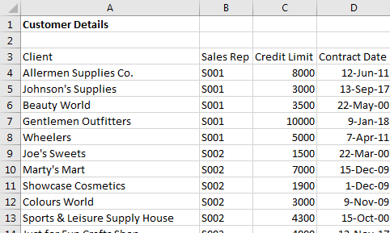
3 – Importing Data Sets
Task: Import data into a spreadsheet application: .csv
Example: Import customer data from a .csv file into Excel
Result: The data is imported into Excel:
Imported Comma Delimited Data
Notes:
Instructor notes:
Cover content in learning materials
References:
ICDL Data Analytics - Foundation 1.0 (3.2 Importing Data From Text Files)
Further Resources:

Slide 9

3 – Importing Data Sets
Task: Import data into a spreadsheet application: spreadsheet
Example: Import ticket sales data from a spreadsheet into Excel.
Steps:
Open the Trips.xlsx workbook.
On the Data tab, in the Get External Data group, click Existing Connections.
In the Existing Connections dialog box, click Browse for More.
Locate and select the Ticket Sales.xlsx workbook.
Click Open.
In the Select Table dialog box, select Promotion Sales.
Click OK.
In the Import Data dialog box, ensure the option Existing worksheet is selected, click cell A3.
Click OK.
Notes:
Instructor notes:
Cover content in learning materials
References:
ICDL Data Analytics - Foundation 1.0 (3.3 Importing Data From Spreadsheets)
Further Resources:

Slide 10
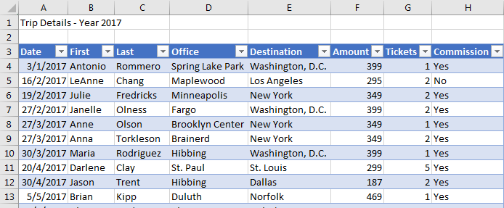
3 – Importing Data Sets
Task: Import data into a spreadsheet application: spreadsheet
Example: Import ticket sales data from a spreadsheet into Excel.
Result: The data is imported into Excel:
Imported Spreadsheet Data
Notes:
Instructor notes:
Cover content in learning materials
References:
ICDL Data Analytics - Foundation 1.0 (3.3 Importing Data From Spreadsheets)
Further Resources:

Slide 11

3 – Importing Data Sets
Task: Import data into a spreadsheet application: website table
Example: Import exchange rate data from a web page into Excel.
Steps:
Open the Rates.xlsx workbook.
On the Data tab, in the Get External Data group, click From Web.
In the New Web Query dialog box, in the Address text box type http://www.icdl.org/exchangerates and click Go.
Click the table selection arrow next to the table to import.
Click Import.
In the Import Data dialog box, ensure the option Existing worksheet is selected and click on cell B3.
Click OK.
Notes:
Instructor notes:
Cover content in learning materials
References:
ICDL Data Analytics - Foundation 1.0 (3.4 Importing Data From Website tables)
Further Resources:

Slide 12
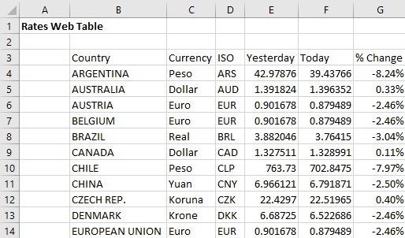
3 – Importing Data Sets
Task: Import data into a spreadsheet application: website table
Example: Import exchange rate data from a web page into Excel.
Result: The data is imported into Excel:
Imported
Web Table
Notes:
Instructor notes:
Cover content in learning materials
References:
ICDL Data Analytics - Foundation 1.0 (3.4 Importing Data From Website tables)
Further Resources:

Slide 13

3 – Importing Data Sets
Task: Import data into a spreadsheet application: database table
Example: Import customer data from a database table into Excel.
Steps:
Open the Customer Details.xlsx workbook.
On the Data tab, in the Get External Data group, click From Access.
Locate and select the BakeryDatabase database.
Click Open.
Select the table tblCustomers and Click OK.
In the Import Data dialog box, ensure the option Table is selected.
Click OK.
Notes:
Instructor notes:
Cover content in learning materials
References:
ICDL Data Analytics - Foundation 1.0 (3.5 Importing Data From Database Tables)
Further Resources:

Slide 14
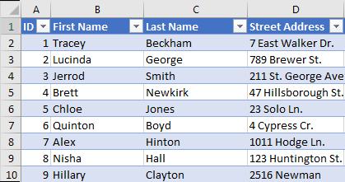
3 – Importing Data Sets
Task: Import data into a spreadsheet application: database table
Example: Import customer data from a database table into Excel.
Result: The data is imported into Excel:
Imported Database Table
Notes:
Instructor notes:
Cover content in learning materials
References:
ICDL Data Analytics - Foundation 1.0 (3.5 Importing Data From Database Tables)
Further Resources:

Slide 15


3 – Importing Data Sets
Learning Objectives Review
You should now be able to:
Import data into a spreadsheet application from a text file
Import data into a spreadsheet application from a spreadsheet
Import data into a spreadsheet application from a website table
Import data into a spreadsheet application from a database table
Notes:
Instructor notes:
Review Learning Objectives

Slide 16


3 – Importing Data Sets
Review Exercise
Notes:
Instructor notes:
Ask participants to complete the Review Exercise to review their knowledge and practice their skills and support them as required.
They will need access to Excel 2016
Review answers with the group
Question answers
1-7 (learner will create Real Estate Imported.xlsx )
References:
ICDL Data Analytics - Foundation 1.0 (3.6 Review Exercise – page 46)
Relevant workfiles in Student folder (Real Estate.csv and Real Estate-Solution.xlsx solution file )

Slide 17
Shaping Data Sets
Lesson 4

Slide 18
4 – Shaping Data Sets
Learning Objectives
After completing this lesson, you should be able to:
Remove duplicate data
Validate that given values belong to a reference data set using the VLOOKUP function
Validate that given values belong to a specific range using one or more IF functions
Extract values from a string using text functions
Notes:
Instructor notes:
Review Learning Objectives

Slide 19

4 – Shaping Data Sets
Concepts: Shaping Data Sets
Before analysis you may need to Shape and Prepare the data set in the Data Preparation phase.
1. Business understanding
2. Data understanding
3. Data preparation
4. Modelling
5. Evaluation
6. Deployment
Data Analysis Phases
Notes:
Instructor notes:
Cover content in learning materials
References:
ICDL Data Analytics - Foundation 1.0 (3.1 Shaping Data Sets Introduction)
Further Resources:

Slide 20


4 – Shaping Data Sets
Concepts: Shaping Data Sets
Shaping and Preparing a data set may include:
Identifying and removing duplicate data
Reconciling data by comparing or matching values
Finding and replacing text
Fixing spelling mistakes
Fixing incorrect formatting
Changing the case of text
Removing extra spaces from text
Fixing number or date and time formats
Merging and splitting columns
Transforming and rearranging columns and rows
Always save a backup copy of the original data set.
Notes:
Instructor notes:
Cover content in learning materials
References:
ICDL Data Analytics - Foundation 1.0 (4.1 Shaping Data Sets Introduction)
Further Resources:

Slide 21
4 – Shaping Data Sets
Task: Remove Duplicate Data.
Example: Remove duplicate salesperson entries from a data set using Excel’s Remove Duplicate tool.
Steps:
Open the Duplicate Records.xlsx workbook.
Copy the range A4:E11 and paste the copied range starting from cell G4 onwards.
Select any cell within the data set that starts from cell G4.
On the Data tab, in the Data Tools group, click Remove Duplicates.
Click OK.
Click OK.
Notes:
Instructor notes:
Cover content in learning materials
References:
ICDL Data Analytics - Foundation 1.0 (4.2 Removing Duplicate Data)
Further Resources:

Slide 22
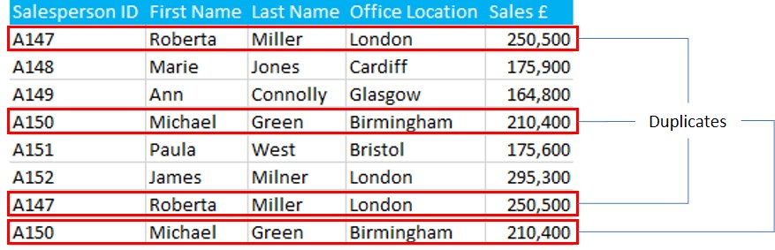
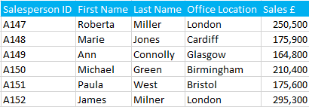
4 – Shaping Data Sets
Task: Remove Duplicate Data.
Example: Remove duplicate salesperson entries from a data set using Excel’s Remove Duplicate tool.
Result: Duplicate entries are removed.
With duplicates
With duplicates removed
Notes:
Instructor notes:
Cover content in learning materials
References:
ICDL Data Analytics - Foundation 1.0 (4.2 Removing Duplicate Data)
Further Resources:

Slide 23
4 – Shaping Data Sets
Concepts: Validating Data Using VLOOKUP
You can use the VLOOKUP function to validate that given values belong to a reference data set.
The VLOOKUP function syntax is:
VLOOKUP (lookup_value, table_array, col_index_num, [range_lookup])
Value or cell reference to look up = the data set to validate. | Name or address of the lookup table = the reference data set. | Column number in the lookup table. | Optional – used to specify if the return value is an exact match (FALSE) or an approximate match (TRUE).
Notes:
Instructor notes:
Cover content in learning materials
References:
ICDL Data Analytics - Foundation 1.0 (4.3 Validating Data Using VLOOKUP)
Further Resources:

Slide 24

4 – Shaping Data Sets
Concepts: Validating Data Using VLOOKUP
You can use the VLOOKUP function to validate that given values belong to a reference data set.
The VLOOKUP function syntax is:
VLOOKUP (lookup_value, table_array, col_index_num, [range_lookup])
Value or cell reference to look up/validate.
Optional – specifies if the return value is an exact match (FALSE) or an approximate match (TRUE).
Name or address of the lookup table/ reference data set.
Column number in the lookup table/reference data set.
Notes:
Instructor notes:
Cover content in learning materials
References:
ICDL Data Analytics - Foundation 1.0 (4.3 Validating Data Using VLOOKUP)
Further Resources:

Slide 25
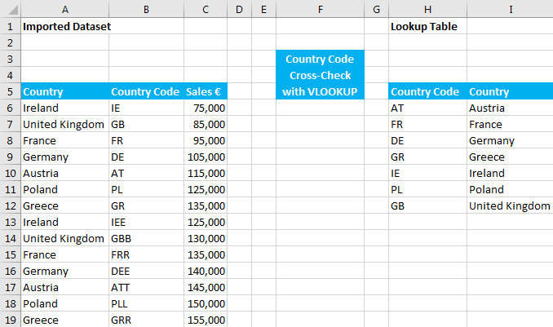
4 – Shaping Data Sets
Task: Validate that given values belong to a reference data set using the VLOOKUP function.
Example: Check if country codes used in the data set are correct by comparing them to the country codes in the reference data set.
Data set to validate
Reference data set
Notes:
Instructor notes:
Cover content in learning materials
References:
ICDL Data Analytics - Foundation 1.0 (4.3 Validating Data Using VLOOKUP)
Further Resources:

Slide 26
4 – Shaping Data Sets
Task: Validate that given values belong to a reference data set using the VLOOKUP function.
Example: Check if country codes used in a data set (B6:B19) are correct by checking if they are exactly the same as country codes in a reference data set (H6:l12).
Steps:
Open Value Validation.xlsx.
Select the cell F6.
Type =VLOOKUP(B6, $H$6:$I$12, 1, FALSE) and press Enter.
Copy the formula to the cell range F7:F19.
Return value
only if it is exact match
=VLOOKUP(B6, $H$6:$I$12, 1, FALSE)
Column
in reference data set from which to return value
Data set
to validate
Reference
data set
Notes:
Instructor notes:
Cover content in learning materials
References:
ICDL Data Analytics - Foundation 1.0 (4.3 Validating Data Using VLOOKUP)
Further Resources:

Slide 27
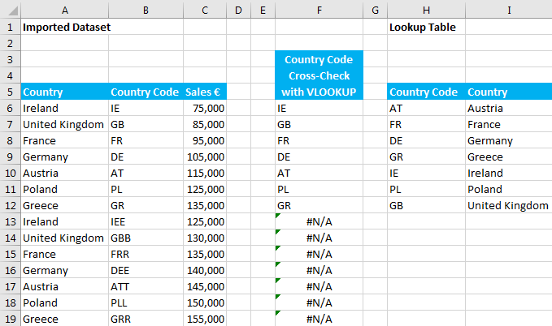
4 – Shaping Data Sets
Task: Validate that given values belong to a reference data set using the VLOOKUP function
Example: Check if country codes used in a data set (B6:B19) are correct by checking if they are exactly the same as country codes in a reference data set (H6:l12).
Result: The country code is returned if it is in the 1st column of the reference data set, otherwise #N/A is returned indicating that the exact value is not found and that the country code in the data set to validate is incorrect.
Data set to validate
Reference data set
Notes:
Instructor notes:
Cover content in learning materials
References:
ICDL Data Analytics - Foundation 1.0 (4.3 Validating Data Using VLOOKUP)
Further Resources:

Slide 28
4 – Shaping Data Sets
Task: Validate that given values belong to a reference data set using the VLOOKUP function
Example: Replace the incorrect country codes with the correct codes.
Steps:
In the Value Validation.xlsx sheet select the cell B13.
Type =VLOOKUP(A13, $H$6:$I$12, 1) and press Enter.
Copy the formula to the cell range B14:B19.
If FALSE isn’t specified, return value
is an approximate match by default
=VLOOKUP(A13, $H$6:$I$12, 1)
Column
in reference data set from which to return value
Data set
to validate
Reference
data set
Notes:
Instructor notes:
Cover content in learning materials
References:
ICDL Data Analytics - Foundation 1.0 (4.3 Validating Data Using VLOOKUP)
Further Resources:

Slide 29
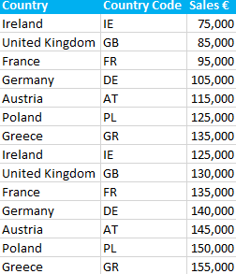
4 – Shaping Data Sets
Task: Validate that given values belong to a reference data set using the VLOOKUP function
Example: Replace incorrect country codes with correct codes.
Result: The data contains the correct codes.
Corrected Data set
Notes:
Instructor notes:
Cover content in learning materials
References:
ICDL Data Analytics - Foundation 1.0 (4.3 Validating Data Using VLOOKUP)
Further Resources:

Slide 30
4 – Shaping Data Sets
Concepts: Validating Data Using IF Functions
You can validate that given values belong to a specified range using one or more IF functions
The IF Function syntax is:
IF(logical_test, [value_if_true], [value_if_false])
You can use multiple IF functions to create complex logical tests by adding IF statements to the value_if_true and value_if_false arguments
A value or logical expression that can be evaluated as TRUE or FALSE.
Optional - the value to return when the logical_test evaluates to TRUE.
Optional - the value to return when the logical_test evaluates to FALSE.
Notes:
Instructor notes:
Cover content in learning materials
References:
ICDL Data Analytics - Foundation 1.0 (4.4 Validating Data Using IF Functions)
Further Resources:

Slide 31
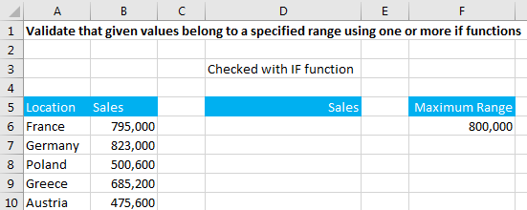
4 – Shaping Data Sets
Task: Validate that given values belong to a specified range using one or more IF functions
Example: Check if the regional sales results are within the maximum range of 800,000.
Notes:
Instructor notes:
Cover content in learning materials
References:
ICDL Data Analytics - Foundation 1.0 (4.4 Validating Data Using IF Functions)
Further Resources:

Slide 32
4 – Shaping Data Sets
Task: Validate that given values belong to a specified range using one or more IF functions
Example: Check if the regional sales results are within the maximum range of 800,000.
Steps:
Open Value Validation.xlsx and go to the IF worksheet.
Select the cell D6.
Type =IF(B6>$F$6,"Error",B6) and press Enter.
Copy the formula to the cell range D7:D10.
If the sales amount in B6 exceeds the range specified in F6, the function returns Error, otherwise it returns the sales amount in B6.
Notes:
Instructor notes:
Cover content in learning materials
References:
ICDL Data Analytics - Foundation 1.0 (4.4 Validating Data Using IF Functions)
Further Resources:

Slide 33
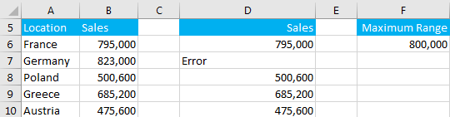
4 – Shaping Data Sets
Task: Validate that given values belong to a specified range using one or more IF functions
Example: Check if the regional sales results are within the maximum range of 800,000.
Result: All the sales results are within the maximum range of 800,000, except for Germany.
Validate for Maximum Range
Notes:
Instructor notes:
Cover content in learning materials
References:
ICDL Data Analytics - Foundation 1.0 (4.4 Validating Data Using IF Functions)
Further Resources:

Slide 34
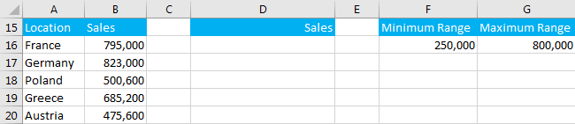
4 – Shaping Data Sets
Task: Validate that given values belong to a specified range using one or more IF functions
Example: Check that regional sales results are within a minimum and maximum range.
Steps:
Go to the IF worksheet in Value Validation.xlsx.
Select the cell D16.
Type =IF(AND(B16>=$F$16,B16<=$G$16),B16,"Error") and press Enter.
Copy the formula to the cell range D17:D20.
Notes:
Instructor notes:
Cover content in learning materials
References:
ICDL Data Analytics - Foundation 1.0 (4.4 Validating Data Using IF Functions)
Further Resources:

Slide 35
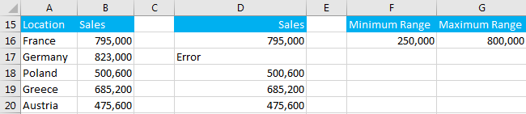
4 – Shaping Data Sets
Task: Validate that given values belong to a specified range using one or more IF functions
Example: Check that regional sales results are within a minimum and maximum range.
Result: All the sales results are within the range, except for Germany.
Validate for Minimum and Maximum Range
Notes:
Instructor notes:
Cover content in learning materials
References:
ICDL Data Analytics - Foundation 1.0 (4.4 Validating Data Using IF Functions)
Further Resources:

Slide 36
4 – Shaping Data Sets
Task: Validate that given values belong to a specified range using one or more IF functions
Example: Check that regional sales results are within a minimum and maximum range.
Alternatively, use a nested IF function in cell D16:
=IF(B16>$G$16,"Error",IF(B16<$F$16,"Error", IF(B16<$G$16,B16)))
=IF(B16>$G$16,"Error",IF(B16<$F$16,"Error", IF(B16>$F$16,B16)))
Validate for Minimum and Maximum Range
Notes:
Instructor notes:
Cover content in learning materials
References:
ICDL Data Analytics - Foundation 1.0 (4.4 Validating Data Using IF Functions)
Further Resources:

Slide 37
4 – Shaping Data Sets
Concepts: Extracting Data.
A common task in cleaning data is to extract parts of data and parse it to separate columns - for example:
splitting the first name and last name contained in one cell into two columns
splitting an address contained in one cell into several columns.
Text functions commonly used to do this are:
LEFT
RIGHT
MID
LEN
FIND
You can combine functions to complete more complex tasks.
Notes:
Instructor notes:
Cover content in learning materials
References:
ICDL Data Analytics - Foundation 1.0 (4.5 Extracting Values using Text Functions)
Further Resources:

Slide 38

4 – Shaping Data Sets
Task: Extract values from a string using text functions
Function | Syntax | Extracts…. | Example
1. LEFT | LEFT(text, [num_chars]) | …specified number of characters from left side of a string. | =LEFT("Ireland",3) What will this return? _________________
2. RIGHT | RIGHT(text, [num_chars]) | …specified number of characters from right side of a string. | =RIGHT("Ireland",3) What will this return? _________________
3. MID | MID(text, start_num, num_chars) | …specified number of characters from specified starting position in a string. | =MID("Ireland",2,3) What will this return? _________________
Notes:
Instructor notes:
Cover content in learning materials
Ask learners what the examples will return.
References:
ICDL Data Analytics - Foundation 1.0 (4.5 Extracting Values using Text Functions)
Further Resources:

Slide 39
4 – Shaping Data Sets
Task: Extract values from a string using text functions
Function | Syntax | Extracts…. | Example
1. LEFT | LEFT(text, [num_chars]) | …specified number of characters from left side of a string. | =LEFT("Ireland",3) What will this return? "Ire"
2. RIGHT | RIGHT(text, [num_chars]) | …specified number of characters from right side of a string. | =RIGHT("Ireland",3) What will this return? "and“
3. MID | MID(text, start_num, num_chars) | …specified number of characters from specified starting position in a string. | =MID("Ireland",2,3) What will this return? “rel"
Notes:
Instructor notes:
Cover content in learning materials
Ask learners what the examples will return.
References:
ICDL Data Analytics - Foundation 1.0 (4.5 Extracting Values using Text Functions)
Further Resources:

Slide 40
4 – Shaping Data Sets
Task: Extract values from a string using text functions
Function | Syntax | Extracts…. | Example
4. LEN | LEN(text) | …..the length of a string as a number of characters. | =LEN("Ireland") What will this return? _________________
5. FIND | FIND (find_text, within_text, [start_num]) | …. the position, as a number, of one text string inside another string. If the text is not found, FIND returns a #VALUE error. | =FIND("land","Ireland",1) What will this return? _________________
Notes:
Instructor notes:
Cover content in learning materials
Ask learners what the examples will return.
References:
ICDL Data Analytics - Foundation 1.0 (4.5 Extracting Values using Text Functions)
Further Resources:

Slide 41
4 – Shaping Data Sets
Task: Extract values from a string using text functions
Function | Syntax | Extracts…. | Example
4. LEN | LEN(text) | …..the length of a string as a number of characters. | =LEN("Ireland") What will this return? 7
5. FIND | FIND (find_text, within_text, [start_num]) | …. the position, as a number, of one text string inside another string. If the text is not found, FIND returns a #VALUE error. | =FIND("land","Ireland",1) What will this return? 4
Notes:
Instructor notes:
Cover content in learning materials
Ask learners what the examples will return.
References:
ICDL Data Analytics - Foundation 1.0 (4.5 Extracting Values using Text Functions)
Further Resources:

Slide 42
4 – Shaping Data Sets
Task: Extract values from a string using text functions
Function | Syntax | Extracts…. | Example
6. LEFT and LEN | LEFT(text,LEN(text)-n) | .... a specified number of characters from the right. This is useful for values with variable lengths | =LEFT("IrelandIE",LEN("IrelandIE")-2) What will this return? _________________
7. LEFT and FIND | LEFT(text,FIND(character,text)-1) | ….characters from the left side of a string up until a specified character. | =LEFT("Ireland_IE",FIND("_","Ireland_IE")-1) What will this return? _________________
Notes:
Instructor notes:
Cover content in learning materials
Ask learners what the examples will return.
References:
ICDL Data Analytics - Foundation 1.0 (4.5 Extracting Values using Text Functions)
Further Resources:

Slide 43
4 – Shaping Data Sets
Task: Extract values from a string using text functions
Function | Syntax | Extracts…. | Example
6. LEFT and LEN | LEFT(text,LEN(text)-n) | .... a specified number of characters from the right. This is useful for values with variable lengths | =LEFT("IrelandIE",LEN("IrelandIE")-2) What will this return? Ireland
7. LEFT and FIND | LEFT(text,FIND(character,text)-1) | ….characters from the left side of a string up until a specified character. | =LEFT("Ireland_IE",FIND("_","Ireland_IE")-1) What will this return? Ireland
Notes:
Instructor notes:
Cover content in learning materials
Ask learners what the examples will return.
References:
ICDL Data Analytics - Foundation 1.0 (4.5 Extracting Values using Text Functions)
Further Resources:

Slide 44
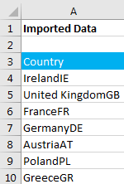
4 – Shaping Data Sets
Task: Extract values from a string using text functions
Example: Split a country and code into separate columns.
Steps:
Open the Text Functions.xlsx workbook.
To extract the country into the cell C4, select the cell C4
Type =LEFT(A4, LEN(A4)-2) and press Enter.
This extracts all the entries in cell A4 except for the last 2 characters.
Copy the formula to the cell range C5:C10.
To extract the country code into the cell D4, select the cell D4.
Type =RIGHT(A4, 2) and press Enter.
This extracts the last 2 characters in cell A4.
Copy the formula to the cell range D5:D10.
Copy the range C4:D10 and paste as values starting from cell F4 onwards.
Country and Code in One Column
Notes:
Instructor notes:
Cover content in learning materials
References:
ICDL Data Analytics - Foundation 1.0 (4.5 Extracting Values using Text Functions)
Further Resources:

Slide 45
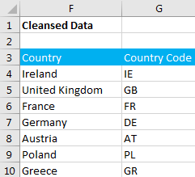
4 – Shaping Data Sets
Task: Extract values from a string using text functions
Example: Split a country and code into separate columns.
Result: The country and code are separated into two columns.
Cleansed Data
Notes:
Instructor notes:
Cover content in learning materials
References:
ICDL Data Analytics - Foundation 1.0 (4.5 Extracting Values using Text Functions)
Further Resources:

Slide 46
4 – Shaping Data Sets
Learning Objectives Review
You should now be able to:
Remove duplicate data
Validate that given values belong to a reference data set using the VLOOKUP function
Validate that given values belong to a specific range using one or more IF functions
Extract values from a string using text functions
Notes:
Instructor notes:
Review Learning Objectives

Slide 47
4 – Shaping Data Sets
Review Exercise
Notes:
Instructor notes:
Ask participants to complete the Review Exercise to review their knowledge and practice their skills and support them as required.
They will need access to Excel 2016
Review answers with the group
Question answers
1-9 (Shipping.xlsx)
References:
ICDL Data Analytics - Foundation 1.0 (4.6 Review Exercise – page 61)
Relevant workfiles in Student folder (Shipping.xlsx and Shipping-Solution.xlsx solution file)

Slide 48
Filtering Data Sets
Lesson 5

Slide 49
5 – Filtering Data Sets
Learning Objectives
After completing this lesson, you should be able to:
Format a data set as table
Insert and use table slicers
Notes:
Instructor notes:
Review Learning Objectives

Slide 50
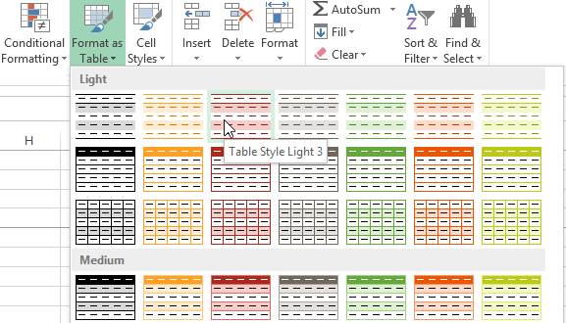
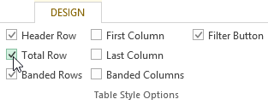
5 – Filtering Data Sets
Task: Format a data set as a built-in table
Example: Format a data set as a table in Excel.
Steps:
Open the Sales.xlsx workbook.
Click on any cell in the data set.
On the Home tab, in the Styles group, click Format as Table.
Select a table style from the drop-down menu.
Click OK in the Format As Table dialog box.
On the Design tab, check or uncheck the desired options in the Table Style Options group.
Table Style Options Group
Notes:
Instructor notes:
Cover content in learning materials
References:
ICDL Data Analytics - Foundation 1.0 (5.1 Formatting Data Sets As Tables)
Further Resources:

Slide 51
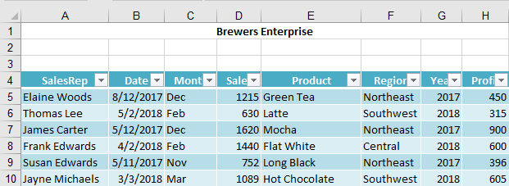
5 – Filtering Data Sets
Task: Format a data set as a built-in table
Example: Format a data set as a table in Excel.
Result: Data set formatted as a table

Slide 52

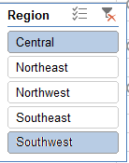
5 – Filtering Data Sets
Task: Insert and use table slicers
Example: Create and use slicers to filter sales information by region and year.
Steps:
Open the Slicers.xlsx workbook.
Click on any cell in the table.
On the Table Tools, Design tab, in the Tools group, click Insert Slicer.
In the Insert Slicers dialog box, select the Region and Year fields (columns).
Click OK.
Click and drag to position the slicer.
Resize the slicers using the sizing handles.
In each slicer, click the items on which you want to filter.
To select multiple items, press CTRL, and click the items.
To clear the filter, use the Clear Filter button.
Selecting Multiple items

Slide 53
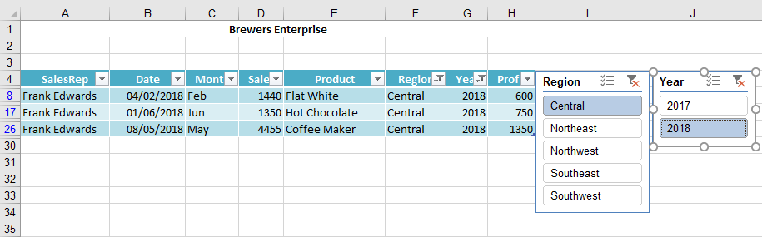
5 – Filtering Data Sets
Task: Insert and use table slicers
Example: Create and use slicers to filter sales information by region and year.
Result: Using slicers to show the data for the Central Region for 2018

Slide 54
5 – Filtering Data Sets
Learning Objectives Review
You should now be able to:
Format data set as table
Insert and use table slicers
Notes:
Instructor notes:
Review Learning Objectives

Slide 55
5 – Filtering Data Sets
Review Exercise
Notes:
Instructor notes:
Ask participants to complete the Review Exercise to review their knowledge and practice their skills and support them as required.
They will need access to Excel 2016
Review answers with the group
Question answers
1-7 (Regional Sales.xlsx and Regional Sales –Solution.xlsx )
References:
ICDL Data Analytics - Foundation 1.0 (5. 3 Review Exercise – page 70)
Relevant workfiles in Student folder (Regional Sales.xlsx and Regional Sales –Solution.xlsx )

Slide 56
2 - Data Set Preparation
Category Learning Objectives Review
You should now be able to:
Import data into a spreadsheet.
Prepare data for analysis using data cleansing techniques
Prepare data for analysis using data filtering techniques
Notes:
Instructor notes:
Review session/category level learning objectives

Slide 57

Questions
Notes:
Instructor notes:
Ask participants if they have any questions on this category before moving onto the next category

